Slide 1
Surgical/Sterile Processing Technician
Program Guide
Prepared For: [Insert StudentName]
Estimated Start Date: [Insert Date]
Program Cost: $6,000.00
Program Code: ST-9000

Slide 2
Surgical/Sterile Processing Technician
Details

Slide 3
What is a Surgical/Sterile Processing Tech?
Surgical/ Sterile Processing Technicians receives, documents, packages, sterilizes, stores and/or issues instruments, equipment, and supplies for patient care. In addition to the sterile processing responsibilities, the technician must also be able to assist in the care of patients of all ages before, during, and after surgical procedures by performing scrub duties and related functions as a member of the surgical team. The technician maintains patient safety, privacy, and confidentiality, and complies with legal aspects of patient care. The technician complies with sterilization standards for handling sharp or contaminated instruments.
This program is ideal for individuals who are meticulous and who desire to be part of a highly skilled team in a growing field. To be successful, individuals must be able to work under stressful and emergency situations. They must be able to act quickly and accurately, and work well with other people. Because of the physical requirements of the job, techs must generally have a strong manual dexterity and physical stamina.
The standard for performance in the operating room is set high, and there is little to no tolerance for careless mistakes or inattentiveness. Surgical Technologists along with all other operating room personnel, must be able to learn to manage stress and thrive within these expectations. While much of this is gained from experience, solid organizational skills are required from day one. The surgical technologist must be able to remain focused and attentive to details. Above all, teamwork and professionalism are an absolute must.
This program is designed for those that might be new to the field, or for experienced hospital/surgical staff seeking a career change, upskilling, (re)certification, or higher earning power. Because every hospital or surgical center in the U.S. has a need for this role, there are ample opportunities in most geographic areas.

Slide 4
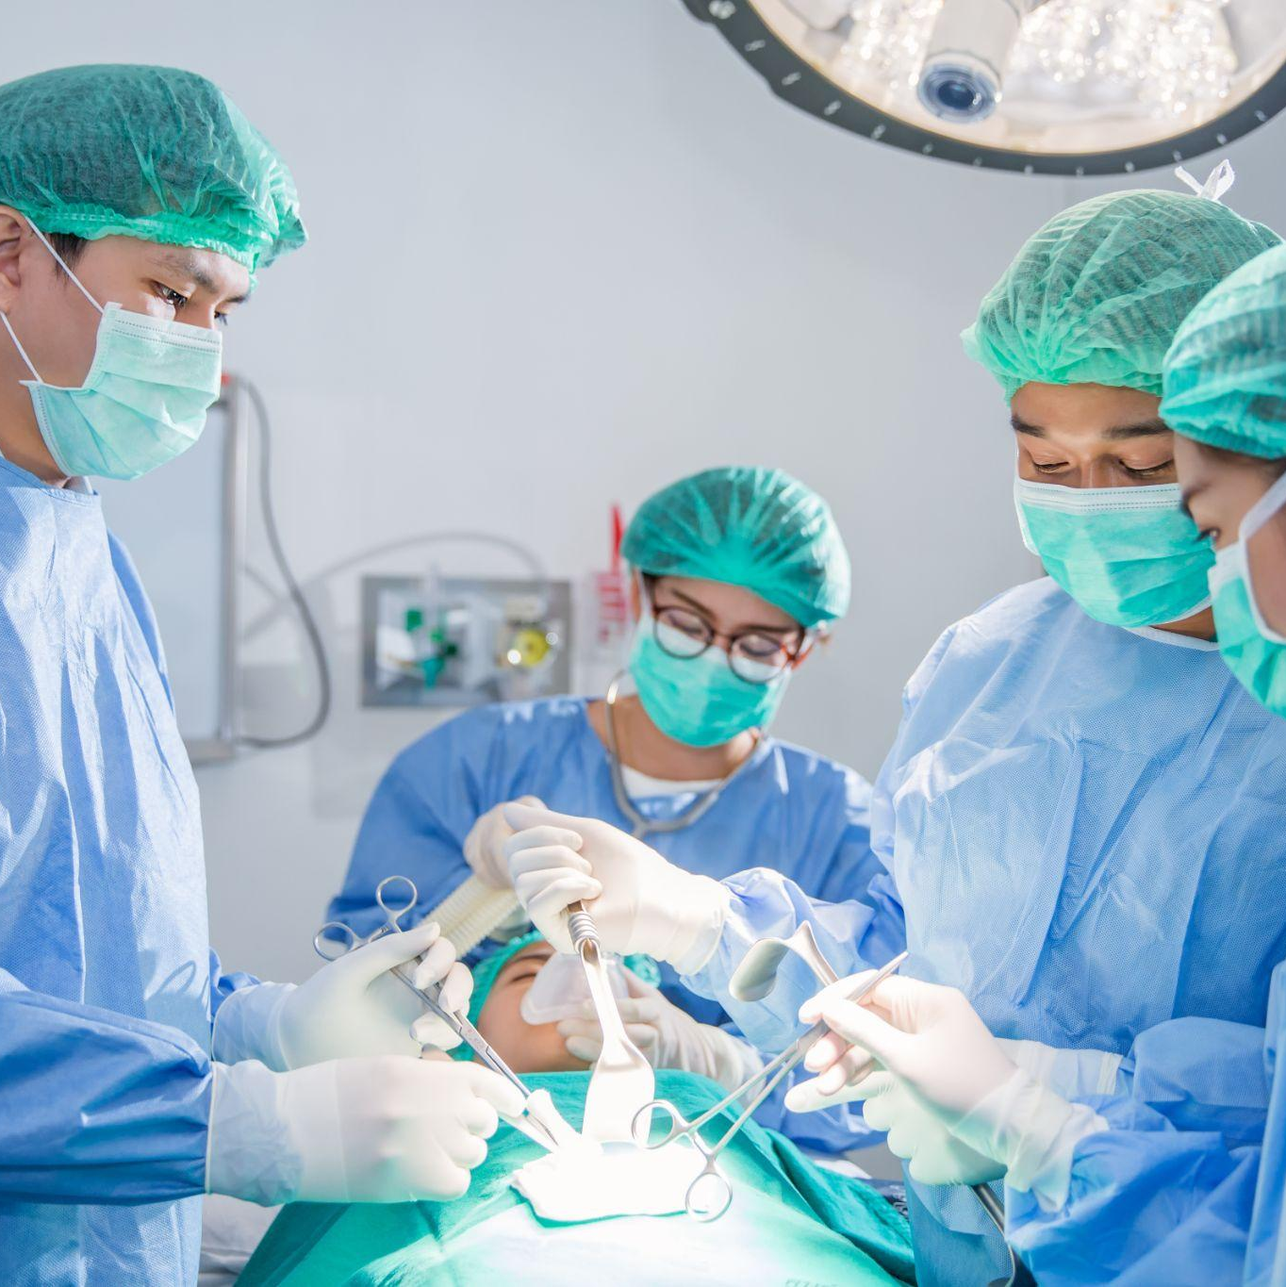
Program Description
The Surgical/Sterile Processing Technician is a comprehensive program that combines the duties of Surgical Technology and Sterile Processing, allowing graduates to wear multiple hats in a clinical setting. In this unique role, the technician receives, documents, packages, sterilizes, stores and/or issues instruments, equipment and supplies for use in medical procedures. Sterile Processing Technicians perform some of the most critical safety tasks that exist in the healthcare sector- preventing infection and the spread of illness by working behind the scenes to sterilize all surgical instruments.
The MedCerts Surgical/Sterile Processing Technician program provides students with immersive and virtual hands-on learning experiences that allow for demonstration of key clinical skills. Surgical procedures are demonstrated using virtual tools or live-recorded video and are simulated – allowing the students to immerse themselves into a virtual experience that is engaging, safe, and repeatable.
This program prepares students to become Tech in Surgery – Certified (TS-C) by the National Center for Competency Testing (NCCT). After passing the TS-C exam, full certification is obtained after a documented 125 surgical cases have been performed. Professionals who earn the NCT designation have the clinical skills and knowledge for maintaining asepsis during surgery, anticipating the surgeon’s needs, and remaining attentive to all aspects of the surgical procedure to ensure a safe environment for the patient.
NOTE: This program is NOT available to residents of the following states: AR, CT, ID, IL, MA, ND, NV, NY, OR, PA, RI, SC, TN, TX, VA, WI

Slide 5
Program Objectives & Features
Objectives
Gain knowledge and skills in preparation for the CRCST and TS-C credentialing exams
Discuss conduct and expectations of the allied health professional in a surgical environment
Explain the role of the Surgical Technologist as a member of the surgical team
Distinguish preoperative, intraoperative, and postoperative duties
Discuss workplace safety, infection control, handwashing, and use of personal protective equipment (PPE)
Demonstrate instrument identification and passing skills while assisting with surgical procedures
Apply anatomy/physiology and medical terminology knowledge where applicable to surgical team communication
Identify central service workflow processes from cleaning, decontamination, preparation, and packaging to sterilization and storage of surgical instruments and equipment
Differentiate methods of quality control and assurance and the necessity of central service process documentation.
Students receive ongoing support and guidance from a team of instructors, advisors, and online mentors. The registration and cost for the certification exam (CRSCT and TS-C) is covered by MedCerts. For additional information, visit medcerts.com.
Features
Comprehensive New Student Orientation
An assigned Student Support Specialist who provides 1:1 support from start to finish.
Professional support offered through on-demand subject matter experts
12-Month Access to Online Training
Flexible scheduling that allows you to learn at your own pace
Certification Exam Payment and Registration
Exam Preparation Support
Career Services and Experiential Learning Support

Slide 6
Equipment & Courseware/eBooks
MedCerts provides all required courseware, student guides, study guides, and other program supplements and resources. In addition to the online video content, students will be provided access to all relevant labs and online/offline resources as necessary to complete the program. Students must have (or have access to) a computer with high-speed internet (minimum 1.5 Mbps).
Program Components Include
Professionalism for Allied Health (MedCerts) Recorded Video-Based Lecture/Instruction
Professionalism for Allied Health (MedCerts) Skill Presentations and Knowledge Checks
Professionalism for Allied Health Immersive 3D Environment (MedCerts) Critical Thinking Interactivity
Introduction to Human Anatomy & Medical Terminology (MedCerts) Recorded Video-Based Lecture/Instruction
Introduction to Human Anatomy & Medical Terminology: A Course Companion (Reuter, Weiss) MedCerts 1st Edition eText and Workbook
A&P with Medical Terms Flashcards (MedCerts)
Central Service Technical Manual (Healthcare Sterile Processing Association) Copyright 2016, 8th Edition Textbook
Sterile Processing (MedCerts) Recorded Video-Based Lecture/Instruction
Sterile Processing Interactivities (MedCerts) 3D Environment for skill practice
Sterile Processing Interactive Skill Activities (MedCerts) Skill Presentation and Knowledge Checks
Sterile Processing Immersive 3D Environment (MedCerts) Critical Thinking Interactivity
Sterile Processing Task-Based Demonstrations (Envision Copyright 2012-2018)
Surgical Technology; Principles and Practices eBook (Elsevier, Copyright 2022) by Joanna Kotcher-Fuller
Surgical Technology Resources (Elsevier) Skill Demonstration Videos
Surgical Technology (MedCerts) Recorded Video-Based Lecture/Instruction
Surgical Technology Interactive Skill activities (MedCerts) Skill Presentation and Knowledge Checks
Surgical Technology Immersive 3D Environment (MedCerts) Critical Thinking Interactivity
Surgical Technology Simulations (PeriopSim) Simulated Instrumentation and Surgical Skill Practice

Slide 7
Enrollment Eligibility Requirements
Applicants must be 18 years of age or older, and have a High School diploma or GED. Many employers will require that you have suitable vision and hearing (normal or corrected), suitable psychomotor skills, hand-eye coordination, and finger agility, and be able to stand for an extended period.
Program Admission Requirements
Employer/Clinical Sponsorship - Applicants to these programs MUST provide verification that an Employer or Clinical Site has agreed to accept the applicant in efforts to fulfill “surgical case” requirements required for Tech in Surgery (TS-C) certification before enrollment. With this Sponsorship, the student must be guaranteed to perform a minimum of required surgical cases during the term of enrollment or immediately upon completion of their MedCerts program.
The MedCerts Student Clinical Site Information Form must be submitted (https://info.medcerts.com/clinical-site) to MedCerts prior to enrollment.
IMPORTANT: This program does not meet state licensing or regulatory requirements for Surgical Technologists in the following states: AR, CT, ID, IL, MA, ND, NV, NY, OR, PA, RI, SC, TN, TX, VA and WI. Prospective students that intend to work as surgical Tech any any of these states should not enroll in MedCerts Surgical Technologist Program.
Currently New Jersey, New York, Connecticut, Pennsylvania, and Tennessee require certification for Sterile Processing Technicians. Colorado, Massachusetts, and Rhode Island currently have active legislation in the works that will ultimately require certification. In all other states, certification is strictly voluntary, however, state regulations will continue to expand over time.

Slide 8
Surgical/Sterile Processing Technician
Courses

Slide 9
PS-1011: Professionalism in Allied Health
Description
This course will benefit anyone considering a career in allied health, as well as those already working in the field. Allied Health Professionals must be committed to the key attributes of professionalism and strive to reflect this within the delivery of patient-centered safe and effective care. “Professionalism” is a broad term that reflects many different skills and abilities. For an individual to exhibit professionalism, he/she must be armed with specific skills and abilities that do not always show up within certification requirements, or even within a career training curriculum. Soft skills are hard to measure and are typically less well-defined than hard skills. However, soft skills are what set many job candidates apart. Professionalism is not just what one knows, it is how one does their job, how one behaves and how one comes across as they interact with others.
The purpose of this course is to provide students with soft skills training that will provide the tools needed to demonstrate a higher level of professionalism on the job. Key components of the course focus on patient interaction, proper office behavior, medical ethics, diversity and cultural bias, emotional strength, professional appearance and communication. The course maintains a focus on the key attributes that are true markers of professionalism.
This course was created with input from healthcare professionals working in the field, healthcare employers that hire our graduates, professional educators and even former MedCerts students. The end result is a collection of modules that touch on the soft skills that are TRULY important in the real world of allied healthcare. In this course, students are engaged through scenario-based learning that allows for real interaction with virtual co-workers and patients. Additionally, game-based activities keep students engaged and entertained throughout their learning journey.
Course Objectives
Gain an understanding of the expectations of an allied healthcare professional in the workplace
Develop and exercise emotional intelligence, self-management and interpersonal skills
Build and improve internal and external communication skills with all exchanges
Enhance the patient care experience with successful interactions and patient satisfaction
Maintain solution-oriented conversations, manage conflict and build self-confidence

Slide 10
HI-1014: Introduction to Human Anatomy and Medical Terminology
Description
In this Introduction to Human Anatomy & Medical Terminology course, you will uncover the wonderful diversity of the 11 body systems while learning about the medical language that is used to describe them, and the translation of medical records used in the field of healthcare. Within the Anatomy & Physiology section of each Lesson, students will gain comprehensive knowledge of the structure and function of the various organs and systems of the human body. Major diseases and conditions will be presented and explained in the section on Pathology. Throughout each Lesson, the roots of terms are explained to help students understand how medical terminology works in all areas of healthcare and to increase their knowledge and understanding of the material discussed.
This module will provide you with a better understanding and working knowledge of medicine that is required in dictation and translation of medical records used for multiple purposes and job duties in the medical field. Modules include: Introduction to Medical Terminology; Introduction to Anatomy, Physiology and Pathology; Cells – The Foundation of Life; The Human Body; Integumentary System; Skeletal System; Muscular System; Nervous System; Special Senses; Endocrine System; Cardiovascular System; Blood and Immune Systems; Respiratory System; Digestive System; Urinary System; and Reproductive System.
Course Objectives
Recognize the structure and function of the 11 body systems and their organs
Understand the medical language that is used to describe those systems
Analyze and understand medical terms by breaking down their word components
Appreciate the major diseases and conditions related to the human body
Apply your knowledge within the healthcare setting

Slide 11
HI-6014: Sterile Processing
Description
Sterile Processing is a comprehensive course with insight into the role of the professional central service technician as a member of the healthcare team. Video-based lessons include topics of infection control with performance of cleaning, decontamination, disinfection, inspection, packaging and sterilization tasks for reusable basic and complex surgical instruments or devices. The central service department’s role in ancillary department support, customer service, teamwork and task priorities will be a key focus. Inventory management, recordkeeping and quality control will be addressed in relationship to the responsibilities of the successful central service technician.
In this course, students are exposed to a variety of eLearning elements that allow for hands-on interaction with the screen for an engaging education. An immersive environment and interactivities will provide the student opportunities to practice key skills performed as a central service technician. In addition to video-based instruction and 3D environments, a variety of other learning methods are utilized for engagement, entertainment and inspiration throughout training.
Course Objectives
Accumulate basic knowledge and skills required of the effective Central Service Technician
Adhere to OSHA, patient safety, infection control and bloodborne pathogen standard requirements
Demonstrate cleaning, decontamination, disinfection, preparation, packaging and sterilization tasks
Identify inventory management, sterile storage, and transport procedures with quality control and assurance
Discuss accuracy and completeness of data entry, incident reporting and records management
Explain effective customer service, teamwork, work groups and task priorities for the Central Service Department
To prepare students for the Certified Registered Central Service Technician (CRCST) certification exam sponsored by the Healthcare Sterile Processing Association (HSPA).

Slide 12
HI-6016: Surgical Technology
Description
Surgical Technology is a comprehensive course with insight and focus on the role of the Surgical Technologist. The course provides foundational knowledge required of a clinical allied healthcare professional, and has been designed to prepare students to achieve the status of Tech in Surgery- Certified. Emphasis is placed on preoperative, intraoperative, and postoperative duties and related knowledge. This course includes topics related to infection control, use of personal protection equipment (PPE), sterile technique, decontamination and sterilization standards, and surgical instrumentation and equipment. It also addresses surgical pharmacology, aspects of medical law related to the healthcare setting, support of the operative patient, and safety in the operating room.
In this course, students are exposed to a variety of eLearning elements that allow hands-on interaction with the screen of an engaging education. In addition to video-based instruction that provides foundational knowledge, a variety of other learning methods are utilized for engagement, entertainment, and inspiration throughout training. These include interactive skill activities, game-based learning, an immersive environment for critical thinking skills, and hands-on simulations providing the student opportunities to interact within the operating setting while assisting the surgeon, which are key skills for a Surgical Technologist.
Course Objectives
To provide students with the skills and knowledge for the competent, entry-level Surgical Technologist
To familiarize students with the instrumentation and equipment used in the operating room
To develop a strong surgical conscience accountability, and understanding of actions
To instill appropriate ethical, professional, and respectful values while providing patient care
To prepare students for the Tech In Surgery (TS-C) certification exam sponsored by the National Center for Competency Testing (NCCT)

Slide 13
Experiential/Clinical Component
To be eligible for the TS-C certification, graduates must complete CASE DOCUMENTATION.
Case documentation requires:
A minimum of 125 surgical cases, including:
A minimum of 30 scrubs in general surgery (with a maximum of 50)
A minimum of 75 scrubs in at least (3) three of the following areas: Gynecology, Genitourinary, Cardiovascular, Neurosurgery, Obstetrics. Thoracic, Peripheral Vascular, Ophthalmology, Otorhinolaryngology, Plastic/Reconstructive, other (specify).
At least 90 of the 125 cases must be 1st scrub cases.
Students are responsible for locating and securing a site to fulfill the clinical requirements of the program. MedCerts cannot guarantee placement to complete this clinical requirement.
Career Services and Job Search Support
The MedCerts Career Services Team works with local, regional and national employers to identify potential employment opportunities, as well as sites to complete clinical requirements, as needed. While we can’t guarantee employment, our goal is to prepare you for a successful job search with skills you can use throughout your career.
*MedCerts does not guarantee employment or clinical site placement.

Slide 14
Eligible Program Certifications

Slide 15
Tech in Surgery- Certified (TS-C)
The Tech in Surgery- Certified (TS-C) credential is offered through the National Center for Competency Testing (NCCT). Established in 1989, National Center for Competency Testing (NCCT) is an independent credentialing organization that has tested more than 500,000 healthcare professional and instructors throughout the United States.
Obtaining TS-C Certification demonstrates knowledge in several science and medical topics, surgical technician skill areas, and safety regulations. The TS-C exam covers topics such as medical terminology, asepsis and infection control, pharmacology, OSHA regulations, surgical knowledge, and other career skills. After passing the exam and becoming certified, the TS-C certification must be renewed each year through continuing education, some of which is offered by the NCCT.
The test covers the following topics:
The TS-C exam contains 175 scored items, 25 unscored pretest items, and candidates are allowed four (4) hours to complete the examination. This certification examination is comprised of 95-98% standard, 4-option multiple-choice items and 2-5% alternative items (e.g., Drag and Drop, Multi-select, Hotspot).
The TS-C exam can be taken remotely via online remote proctoring.
Setting up surgical procedure Executing patient safety Assessing the integrity and sterility of items Utilizing preference cards Documenting unusual events Understanding environmental safety Preparing the operating room Documentation | Applying sterile technique Supporting the needs of the surgeon Executing end of procedure tasks Preparing supplies Recognizing post-operative complications Executing end-of-case procedures

Slide 16
Tech in Surgery- Certified (TS-C) cont.
The MedCerts Surgical Technologist program is approved by the NCCT on a state x state basis. To be eligible for certification by NCCT, the student must reside in a state where MedCerts is licensed or otherwise authorized to operate as a school/ In the case of an employer partnership, the employer’s physical presence may be substituted.
IMPORTANT: Graduates who attempt to pass the TS-C exam must complete CASE DOCUMENTATION within two (2) years of the test date. Case documentation requires a minimum of 125 surgical cases including a minimum of 50 scrubs in general surgery; a minimum of 20 scrubs in orthopedic surgery; and a minimum of 55 scrubs in at least two of the following areas: Gynecology, Genitourinary, Cardiovascular, Neurosurgery, Obstetrics, Thoracic, Peripheral Vascular, Ophthalmology, Otorhinolaryngology, Plastic/Reconstructive, other (specify).
TS-C Credentialing Exam Details
Issuing Authority: NCCT
Restrictions: High School Graduate or Equivalent
Accreditation: Accredited by NCCA
Number of Questions: 175 Scored Questions, 25 Unscored
Minimum Passing Score: 70%
Exam Time: 4 Hours
Exam Cost: $155 plus $29 Remote Proctoring Fee
Exam Type: Computer Based
Testing Site: Home- Remote Proctored
Renewal Due: Recertification Required Yearly
CE?: Yes- 14 CEs annually

Slide 17
Certified Registered Central Service Technician- Certified (CRCST)
Founded in 1958, the Healthcare Sterile Processing Association (HSPA) is the only full-service Association for Central Sterile Supply Department professionals (formerly known as IAHCSMM). They represent more than 33,000 Central Service (CS) professionals who value the highest interest in education and certification. HSPA’s CRCST certification is accredited by both the American National Standards Institute (ANSI) and the National Commission for Certifying Agencies (NCCA).
IMPORTANT: 400 Hours of Hands-On Experience is REQUIRED for CRCST certification. Students may attempt the CRCST exam before completing the required hours, but they must submit the documentation of hands-on experience, completed on a paid or volunteer basis, within six months of passing the exam. During that six-month period, individuals will be considered provisionally certified. If that experience is not completed and documented within the allotted six-month period, the certification will be revoked, and the individual will need to retest in order to gain certification.
A one-time, two-month provisional extension may be available, if and only if the provisional certificate has already begun working or volunteering in a department before the provisional certification expires. The Supervisor/Manager/Educator of that department would need to contact HSPA to request an extension on the applicant’s behalf, prior to the provisional certification expiring.
The CRCST exam consists of questions covering the following seven (7) knowledge domains:
Cleaning, Decontamination, and Disinfection
Preparation and Packaging
Sterilization Process
Patient Care Equipment
Sterile Storage and Inventory Management
Documentation and Record Maintenance
Customer Relations
Each of these domain is comprised of a series of sub-domains which further details the type and amount of content covered in each section, as well as its weight on the certification exam. Results for the exam will provide a Pass/Fail notice, as well as a section-by-section review for those who do not pass, which will detail if the test taker is at or below the required passing level of each domain. Please review the full CRCST Exam Content Outline for more information.

Slide 18
Certified Registered Central Service Technician- Certified (CRCST) cont.
CRCST Credentialing Exam Details
Number of Questions: 125 Scored Questions, 25 Unscored Pretest Questions.
Global Exam Pass Rate: 77% (2019)
Exam Time: 3 Hours
Exam Cost: $125
Exam Type: Computer-Based
Testing Site: Exclusively at Prometric Testing Centers
Renewal Due: Annually. $50 Renewal Fee and 12 CE Credits Required
Re-take: Mandatory 6-week waiting period between attempts

Slide 19
Potential Careers & Job Outlook

Slide 20
Surgical/ Sterile Processing Technician Careers
There is not specific job/wage data available for an individual working as Surgical Technician while also performing function of a Sterile Processing Technician. Therefore, the salary data presented here is based on Surgical Technician data from bls.gov and Burning Glass.
75 percent of Surgical Techs earned a healthy average salary of between $33,000 and $58,000. Surgical Technologists made a median salary of $49,710 in 2020. The best-paid 25 percent made $60,980 that year, while the lowest-paid 25 percent made $41,010.
Job Outlook for Surgical Techs (2020-2030)- 9% growth
Job Outlook for Sterile Processing Technicians (2018-2028)- 11% growth
O*NET Code: 29-2055.00
Title: Surgical Technologists
Assist in operations, under the supervision of surgeons, registered nurses, or other surgical personnel. May help set up operating room, prepare and transport patients for surgery, adjust lights and equipment, pass instruments and other supplies to surgeons and surgeons' assistants, hold retractors, cut sutures, and help count sponges, needles, supplies, and instruments.
O*NET Code: 31-9093.00
Title: Medical Equipment Preparers
Prepare, sterilize, install, or clean laboratory or healthcare equipment. May perform routine laboratory tasks and operate or inspect equipment.
Sample of reported job titles: Surgical/Sterile Processing Technician, ORT/ Sterile Processing Tech, Travel Surgical Tech, Surgical Services Technician, Central Processing Technician (CPT), Central Service Technician (CST), Central Sterile Supply Technician (CSS Technician), Central Sterile Tech/Surgical Tech, Certified Registered Central Service Technician (CRCST), Instrument Technician, Sterile Preparation Technician, Sterile Processing and Distribution Technician (SPD Tech), Sterile Processing Technician (Sterile Processing Tech), Sterile Technician, Medical Equipment Preparer, Sterilization Technician, Certified Surgical Technician, Certified Surgical Technologist (CST), Operating Room Surgical Technician (OR St), Operating Room Technician (OR Tech), Operating Room Technologist (OR Tech), Surgical Scrub Technician, Surgical Scrub Technologist (Surgical Scrub Tech), Surgical Technician, Surgical Technologist (Surgical Tech)

