Slide 1
Phlebotomy Technician
Program Guide
Prepared For: [Insert StudentName]
Estimated Start Date: [Insert Date]
Program Cost: $2000.00
Program Code: HI-6100

Slide 2
Phlebotomy Technician Details

Slide 3
What is a Phlebotomist?
Phlebotomists collect blood for donation or for testing, so the blood can be analyzed in a clinical laboratory. Blood tests are used to diagnose illness, evaluate the effectiveness of medications and determine whether a patient is receiving proper nutrition. Phlebotomists may also be required to collect non-blood specimens such as urine or throat swabs for testing. Phlebotomists work in clinical laboratories, hospitals, community health centers, nursing homes, doctor’s offices, blood donation centers and other health care facilities. They are usually supervised by a clinical laboratory technologist or other medical professional.
Phlebotomists talk with patients and donors to help them feel less nervous about having their blood drawn. They verify the patient’s identity to ensure proper labeling of the blood and enter patient information in a database. Phlebotomists will also assemble and maintain instruments such as needles, test tubes, and blood vials and will be required to maintain a clean, sanitary, and safe work environment to avoid infection or other complications.
In medical and diagnostic laboratories, patient interaction is sometimes only with the phlebotomist. Because all blood samples look the same, phlebotomists must carefully identify and label the sample that have drawn and enter it into a database. Some phlebotomists draw blood for other purposes, such as at blood drives where people donate blood. To avoid causing infection or other complications, phlebotomists must keep their work area and instruments clean and sanitary.
According to the US Bureau of Labor Statistics (BLS), the field of Phlebotomy is expected to grow 25% by 2026, which is much faster than average for all occupations. In this field, certification is important to stand out in a competitive market. While certification may not be required, employers prefer hiring individuals who have demonstrated mastery of Phlebotomy
skills and concepts through certification. The Certified Phlebotomy
Technician (CPT) certification is ideal for those looking for career
enhancement and advancement, and to gain earning power
in a competitive market.

Slide 4
Program Description
The MedCerts online Phlebotomy Technician program prepares students to gain industry certification and ultimately to work with patients in hospitals, clinics, physician’s offices, and other healthcare facilities. Our highly immersive program utilizes 12 unique eLearning components designed to keep students engaged, stimulated, and entertained throughout their training. The student learning experience is driven by recorded video lecture delivered by expert instructors, with simulations, 3D video demonstrations, 3D interactive training environment, and many other professionally produced learning objects. Multiple assessments test the students’ knowledge and understanding of the material contained in each lesson leading up to a comprehensive final exam for each course.
**PLEASE NOTE: This program is NOT available to students who plan to work in the states of California or Washington. Many states have licensing or certification requirements for those performing the role of a Phlebotomist. This MedCerts program is aligned with and/or prepares candidates for certification or licensure in each state except California and Washington.

Slide 5
Program Objectives & Features
Objectives
Gain knowledge of medical terminology, disease processes, anatomy and physiology
Become familiar with healthcare settings and the role of the phlebotomy technician
Understand the responsibilities of patient care and safety related to preparation and collection complications
Grasp the importance of customer service, communication skills and professionalism
Appreciate the role of HIPAA, OSHA, COLA, and CLIA-waived testing
Target certification is Certified Phlebotomy Technician (CPT)
Students receive ongoing support and guidance from a team of instructors, advisors, and online mentors. The registration and cost for the certification exam (CPT) is covered by MedCerts. For additional information, visit MedCerts.com.
Features
Comprehensive New Student Orientation
An assigned Student Support Specialist who provides 1:1 support from start to finish.
Professional support offered through on-demand subject matter experts
12-Month Access to Online Training
Flexible scheduling that allows you to learn at your own pace
Certification Exam Payment and Registration
Exam Preparation Support
Career Services and Experiential Learning Support

Slide 6
Equipment & Courseware/eBooks
Students must have (or have access to) a computer with high-speed internet (minimum 1.5Mbs). MedCerts provides all required courseware, student guides, study guides and other program supplements and resources. In addition to the online video content, students will be provided access to all relevant labs and online/offline resources as necessary to complete the program.
Program Components Include
Introduction to Human Anatomy & Medical Terminology (MedCerts) Recorded Video-Based Lecture/Instruction
Introduction to Human Anatomy & Medical Terminology: A Course Companion (Reuter, Weiss) MedCerts 1st Edition eText and Workbook
A&P with Medical Terms Flashcards (MedCerts) MedCerts
Phlebotomy (MedCerts) Recorded Video-Based Lecture/Instruction
Phlebotomy Worktext and Procedures Manual 4E (Elsevier Copyright 2016) by Warekois and Robinson eBook (from VitalSource)
Phlebotomy Procedure Videos (Elsevier Copyright 2016)
Drag and Drop Exercises Interactive Lesson Review (Elsevier Copyright 2016)
Phlebotomy Storyline Animations Skill Presentations and Knowledge Checks (MedCerts)
Phlebotomy Technician 3D Virtual Scenarios (MedCerts)
Phlebotomy and Capillary Procedures Simulation Training (SIMTICs)

Slide 7
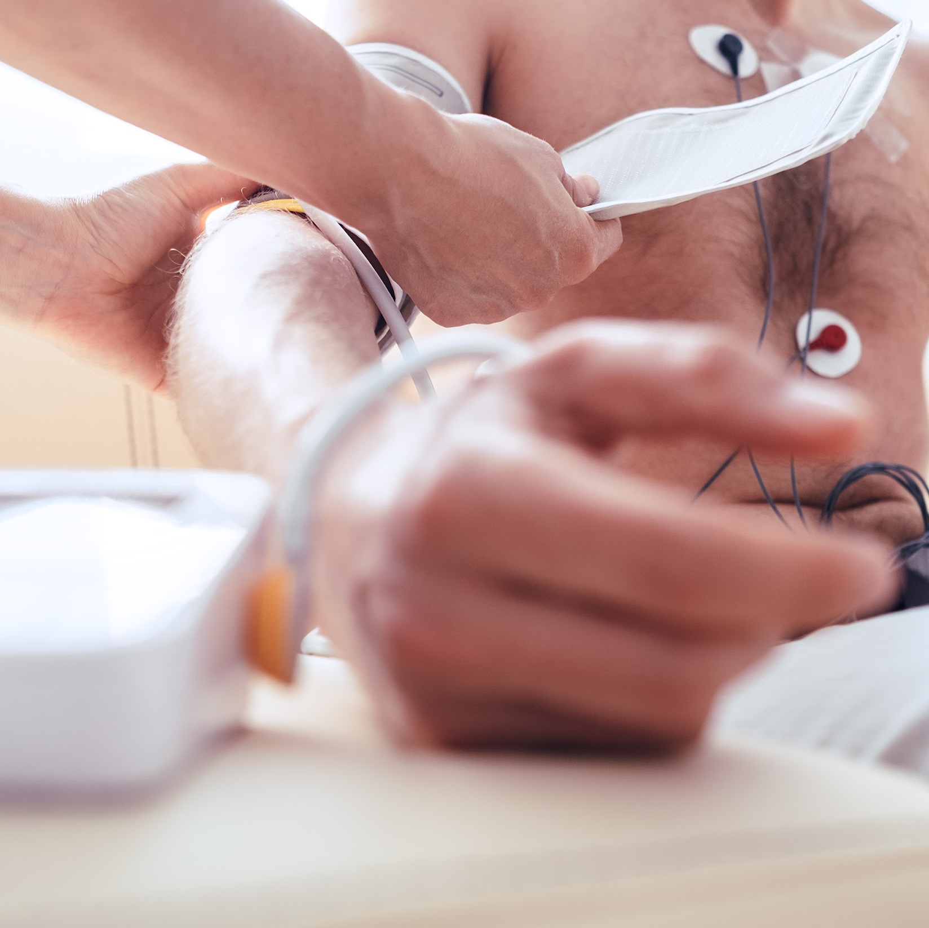
Enrollment Eligibility Requirements
Applicants must be 18 years of age or older and have a High School diploma or GED. Many employers will require that you have suitable vision and hearing (normal or corrected), suitable psychomotor skills, hand-eye coordination, and finger agility, and be able to stand for an extended period.
**PLEASE NOTE:
1) This program is NOT available to students who plan to work in the states of California or Washington. Many states have licensing or certification requirements for those performing the role of a Phlebotomist. This MedCerts program is aligned with and/or prepares candidates for certification or licensure in each state except California and Washington.
2) While MedCerts training and related target certifications may be accepted and/or approved by your state of residency, employers reserve the right to dictate pre-requisite education, experience, or certification/licensure requirements for their positions. We strongly advise students to research target job posts from area employers and relevant state requirements, barriers, or restrictions prior to enrollment to ensure eligibility upon graduation.

Slide 8
Phlebotomy Technician Courses

Slide 9
PS-1011: Professionalism in Allied Health
Description:
This course will benefit anyone considering a career in allied health, as well as those already working in the field. Allied Health Professionals must be committed to the key attributes of professionalism and strive to reflect this within the delivery of patient-centered safe and effective care. “Professionalism” is a broad term that reflects many different skills and abilities. For an individual to exhibit professionalism, he/she must be armed with specific skills and abilities that do not always show up within certification requirements, or even within a career training curriculum. Soft skills are hard to measure and are typically less well-defined than hard skills. However, soft skills are what set many job candidates apart. Professionalism is not just what one knows, it is how one does their job, how one behaves and how one comes across as they interact with others.
The purpose of this course is to provide students with soft skills training that will provide the tools needed to demonstrate a higher level of professionalism on the job. Key components of the course focus on patient interaction, proper office behavior, medical ethics, diversity and cultural bias, emotional strength, professional appearance and communication. The course maintains a focus on the key attributes that are true markers of professionalism.
This course was created with input from healthcare professionals working in the field, healthcare employers that hire our graduates, professional educators and even former MedCerts students. The end result is a collection of modules that touch on the soft skills that are TRULY important in the real world of allied healthcare. In this course, students are engaged through scenario-based learning that allows for real interaction with virtual co-workers and patients. Additionally, game-based activities keep students engaged and entertained throughout their learning journey.
Course Objectives:
Gain an understanding of the expectations of an allied healthcare professional in the workplace
Develop and exercise emotional intelligence, self-management and interpersonal skills
Build and improve internal and external communication skills with all exchanges
Enhance the patient care experience with successful interactions and patient satisfaction
Maintain solution-oriented conversations, manage conflict and build self-confidence

Slide 10
HI-1014: Introduction to Human Anatomy and Medical Terminology
Description:
In this Introduction to Human Anatomy & Medical Terminology course, you will uncover the wonderful diversity of the 11 body systems while learning about the medical language that is used to describe them, and the translation of medical records used in the field of healthcare. Within the Anatomy & Physiology section of each Lesson, students will gain comprehensive knowledge of the structure and function of the various organs and systems of the human body. Major diseases and conditions will be presented and explained in the section on Pathology. Throughout each Lesson, the roots of terms are explained to help students understand how medical terminology works in all areas of healthcare and to increase their knowledge and understanding of the material discussed.
This module will provide you with a better understanding and working knowledge of medicine that is required in dictation and translation of medical records used for multiple purposes and job duties in the medical field. Modules include: Introduction to Medical Terminology; Introduction to Anatomy, Physiology and Pathology; Cells – The Foundation of Life; The Human Body; Integumentary System; Skeletal System; Muscular System; Nervous System; Special Senses; Endocrine System; Cardiovascular System; Blood and Immune Systems; Respiratory System; Digestive System; Urinary System; and Reproductive System.
Course Objectives:
Recognize the structure and function of the 11 body systems and their organs
Understand the medical language that is used to describe those systems
Analyze and understand medical terms by breaking down their word components
Appreciate the major diseases and conditions related to the human body
Apply your knowledge within the healthcare setting

Slide 11
HI-6011: Phlebotomy
Description:
Phlebotomy is a comprehensive course with insight and focus on specimen collection for diagnostic testing in the healthcare facility, providing foundational knowledge required for an allied healthcare professional. Video-based lessons include fundamentals of phlebotomy with emphasis on infection control, safety, communication skills, patient care and preparation, venipuncture equipment and supplies, specimen collection, handling, transport, and processing.
In this course, students are exposed to a variety of eLearning elements that allow for hands-on interaction with the screen for an engaging education. Simulations will provide the student opportunities to practice key phlebotomy skills performed in a medical facility. In addition to video-based instruction and simulation, a variety of other learning methods are utilized for engagement, entertainment and inspiration throughout training.
Course Objectives:
Recognize the importance of infection control and safety compliance with diagnostic testing
Understand the responsibilities of teamwork and communication skills in the healthcare setting
Appreciate the role of the Phlebotomy Technician in patient care, preparation and venipuncture
Identify proper organization and utilization of specimen collection equipment and supplies
Gain and understanding of blood and non-blood collections, handling, transport, and processing

Slide 12
Experiential Learning Opportunity
Description:
Upon completion of this program, students wishing to sit for the Certified Phlebotomy Technician exam will be required to complete 30 venipunctures and 10 capillary sticks on a live person. Students should already be working in the field to complete this requirement.
Career Services and Experiential Learning Support
MedCerts Careers Services Advisors work with local, regional and national employers to find Experiential Learning opportunities for students during and after their MedCerts program. Our primary goal is to find full-time job placement for every student. If immediate employment is not an option, our team will work with students to find Experiential Learning opportunities to provide hands-on experience. Typical Experiential Learning options include job shadowing experiences, volunteer opportunities, externships or internships. Experiential Learning allows us to tailor our efforts to what works in each healthcare market to match the needs of employers and students.
*This program has a clinical requirement of 30 venipuncture and 10 capillary sticks on live individuals to sit for their certification exam. MedCerts cannot guarantee they will find a student a site to complete this clinical requirement, so only students employed in a healthcare facility or take full responsibility for meeting their clinical requirements will be admitted to the program.

Slide 13
Eligible Program Certifications

Slide 14
Certified Phlebotomy Technician (CPT)
Hospitals, laboratories, and other employers have an increasing demand for phlebotomists. Most seek, and many require, a professional certification. With a CPT certification, you’ll have the credentials you need to set yourself apart from other applicants as you embark on a rewarding healthcare career. As more employers require phlebotomy certifications, a CPT will help improve your marketability in a growing and rewarding field.
Common duties of Phlebotomists include tasks like:
Draw blood from patients and blood donors
Evaluate patients’ ability to withstand procedure
Explain blood-drawing procedure to patients and answer questions
Perform basic point of care testing, such as blood glucose levels
Prepare blood, urine and other specimens for testing
Verify patient/donor identity
Maintain medical equipment such as needles, test tubes, and blood vials
Having a nationally accredited certification, like the CPT, can help you stand out. Certification may also be required or preferred for certain job opportunities in the profession.
Phlebotomy Technicians are critical team members at hospitals, diagnostic laboratories, and blood donor centers. As advancements in medical technology rise, it’s an especially exciting time to being a career in this thriving field. Earning your Phlebotomy Technician Certification (CPT) from NHA can give employers confidence in your skills and abilities. Set yourself up for success and reach your career goals in the rewarding healthcare industry.
Candidate Eligibility
Each candidate must be able to provide evidence that he/she has performed a minimum of:
30 successful venipunctures
10 successful capillary sticks
CPT Certification Exam Details:
Number of Questions: 100 Questions, 20 pretest questions
Exam Time: 2 Hours
Passing Score: 390/500
NHA National Pass Rate: 78.5%
NHA Total Certified in 2018: 37,085
Total Currently Certified: 89,554

Slide 15
Potential Careers & Job Outlook

Slide 16
Phlebotomy Technician Careers
The Phlebotomy Technician program prepares students for a career as a Phlebotomist and other closely related careers, which have a projected job growth of 24.5%, and has been identified as a Bright Outlook Occupation based on Bureau of Labor Statistics (www.bls.gov). Bright Outlook Occupations are expected to grow rapidly in the next several years or will have large numbers of job openings.
PRIMARY O*NET CODE: 31-9097.00 – Phlebotomists
Phlebotomists draw blood for tests, transfusions, research, or blood donations. Some explain their work to patients and provide assistance when patients have adverse reactions after blood is drawn. Phlebotomists work mainly in hospitals, medical and diagnostic laboratories, blood donor centers, and doctors’ offices.
Sample of reported job titles: Common job titles: Clinical Laboratory Technician, Medical Laboratory Technician, Laboratory Specimen Processor, Pathology Laboratory Technician, Sterile Processing Technician, Endoscopy Technician, Medical Technologist, Emergency Room/Department Technician, Blood Bank Technologist, Medical Assistant, Lab Assistant, Patient Service Technician, Phlebotomist Supervisor/Instructor, Phlebotomist, Medical Lab Assistant, Phlebotomy Director, Phlebotomy Program Coordinator, Phlebotomy Supervisor
2017 Median Wages: $16.19 hourly, $33,670 annual
Top Employers Nationally: Quest Diagnostics Incorporated, Laboratory Corporation of America, American Red Cross, CSL Plasma, Community Health Systems Professional Services Corporation, Grifols, Hospital Corporation of America, BioReference Laboratories, and Ascension Health

