Slide 1


Patient Care Technician
Program Guide
Prepared For: [Student Name]
Estimated Start Date: [Start Date]
Program Cost: $4000.00
Program Code: HI-7000

Slide 2

Patient Care Technician Details

Slide 3


What is a Patient Care Technician?
The care of patients involves not only treating disease and injury, but also preventing disease, restoring optimal wellness through rehabilitation, caring for the chronically ill, and educating patients and families. To identify the individual needs of the patient and to plan systematic approach to meet those needs, nurses (or other qualified health professionals) participate in developing an individualized care plan. Its development involves the patient and all healthcare providers who, through a coordinated and cooperative effort, work towards meeting the patient’s total needs in a holistic caring manner. A Patient Care Technician assists in carrying out the care plan by completing the tasks assigned to him/her.
Doctors, nurses, and other healthcare professionals rely on Patient Care Technicians to assist with the critical day-to-day care some patients require. As a Patient Care Technician, individuals provide hands-on assistance to serve patients’ basic needs, as well as work alongside other healthcare professionals.
A Patient Care Technician provides assistance and basic care to patients in hospital settings, physicians’ offices, nursing homes, rehabilitation centers, and long-term facilities.
A Patient Care Technician checks patients’ blood pressure, pulse, and temperature and assists doctors performing physical exams. He/she also changes bedding, feeds, and helps patients perform self-care tasks like bathing and using the restroom. More and more patients require special care, sometimes around-the-clock. Needs vary from patient to patient, making it vital that the Patient Care Technician has a diverse range of knowledge and skills to provide their basic care.
Patient Care Technicians primarily work under the supervision of a nurse
but may occasionally work under the supervision of a provider such as
a physician. A Patient Care Technician is sometimes referred to as
a Nursing Assistant, and they often perform many of the same
job duties.

Slide 4
What is a Patient Care Technician? (cont.)
Patient Care Technicians are trained to perform more technical medical procedures and duties than a typical Nursing Assistant, such as blood draws, EKGs, lab tests, blood glucose tests, and exercise/nutrition/diet monitoring. Training to become a PCT is typically longer, more demanding, and involves more clinical and laboratory functions. The requirements for becoming a Certified Nursing Assistant (CNA) vary from state to state.
A Certified Patient Care Technician carries a nationally accredited certification and is not tied to any state-run certification or license. Often, Patient Care Technicians choose to obtain a certification
as both a CNA and CPCT.

Slide 5

Program Description
The MedCerts online Patient Care Technician program prepares students to gain industry certification and ultimately to work directly with patients in a variety of healthcare settings. This highly immersive program utilizes up to 12 unique eLearning components designed to keep students engaged, stimulated, and entertained throughout their training. The student learning experience is driven by recorded video lecture delivered by expert instructors, with simulations, video demonstrations, virtualized environments, and many other professionally produced learning objects. Multiple assessments test the students’ knowledge and understanding of the material contained in each lesson leading up to the comprehensive final exam for each course.
The Patient Care Technician program prepares students to assist physicians and nurses by providing basic and advanced clinical duties in a medical environment. The program covers subjects such as anatomy and physiology, medical law and ethics, medical communication, medical records, patient preparation, medical terminology, and basic laboratory procedures and tests. Students will learn to recognized the importance of safety and compliance and understand the role of patient care in the healthcare setting. Because a Patient Care Technician may be called upon to perform a variety of clinical tasks and procedures, this program includes highly focused and comprehensive Phlebotomy and EKG training. Additionally, students learn a wide variety of fundamental clinical tasks designed to produce and graduate with advanced skills that sets him/her apart in a competitive job market.
Upon completion of this program, students will have met the training requirements to sit for the Certified Patient Care Technician (CPCT) exam which is sponsored by the National Healthcareer Association (NHA). Because Customer Service is a priority in situations where direct care or other patient/client interaction occurs, students will learn the fundamentals of Customer Service by completing a module that has been aligned with standards set forth by the
Professional Association for Customer Engagement (PACE). Students
that successfully complete this module will attain the status of
Customer Service Certified (CSC).

Slide 6
Program Objectives & Features
Objectives
Grasp the importance of customer service, communication skills and professionalism
Gain knowledge of medical terminology, disease processes, anatomy and physiology
Recognize the importance of special care, concerns and settings
Understand EKG readings and monitoring vital signs
Become familiar with healthcare settings and the role of the phlebotomy technician
Perform safety checks and ensure cleanliness in patient rooms
Gain an understanding of assistance with activities of daily living
Appreciate the role of patient care in the healthcare setting
Prepare for Certified Patient Care Technician (CPCT) certification exam
Students receive ongoing support and guidance from a team of instructors, advisors, and online mentors. The registration and cost for the certification exam (CPCT) is covered by MedCerts. For additional information, visit MedCerts.com.
Features
Comprehensive New Student Orientation
An assigned Student Support Specialist who provides 1:1 support from start to finish.
Professional support offered through on-demand subject matter experts
12-Month Access to Online Training
Flexible scheduling that allows you to learn at your own pace
Certification Exam Payment and Registration
Exam Preparation Support
Career Services and Experiential Learning Support

Slide 7
Equipment & Courseware/eBooks
Students must have (or have access to) a computer with high-speed internet (minimum 1.5Mbs). MedCerts provides all required courseware, student guides, study guides and other program supplements and resources. In addition to the online video content, students will be provided access to all relevant labs and online/offline resources as necessary to complete the program.
Program Components Include
Introduction to Human Anatomy & Medical Terminology (MedCerts) Recorded Video-Based Lecture/Instruction
Introduction to Human Anatomy & Medical Terminology: A Course Companion (Reuter, Weiss) MedCerts 1st Edition eText and Workbook
A&P with Medical Terms Flashcards (MedCerts) MedCerts
Phlebotomy (MedCerts) Recorded Video-Based Lecture/Instruction
Phlebotomy Worktext and Procedures Manual 4E (Elsevier Copyright 2016) by Warekois and Robinson - eBook (from VitalSource)
Phlebotomy Procedure Videos (Elsevier Copyright 2016)
Drag and Drop Exercises Interactive Lesson Review (Elsevier Copyright 2016)
Phlebotomy Storyline Animations Skill Presentations and Knowledge Checks (MedCerts)
Phlebotomy Technician 3D Videos (MedCerts)
Phlebotomy Technician 3D Virtual Learning Games(MedCerts)
Phlebotomy and Capillary Procedures Simulation Training (SIMTICs)
Electrocardiography (MedCerts) Recorded Video-Based Lecture/Instruction
Electrocardiography for Healthcare Professionals 5E (McGraw Hill Copyright 2019) by Booth and O’Brien - eBook (from VitalSource)
Electrocardiography Storyline Animations Skill Presentations and Knowledge Checks (MedCerts)
EKG Technician 3D Videos (MedCerts)
EKG Technician 3D Virtual Learning Games (MedCerts)

Slide 8
Courseware/eBooks (cont.)
EKG and Analysis Simulation Training (SIMTICs)
Fundamental Concepts and Skills for the Patient Care Technician (Elsevier Copyright 2018) by Townsend Little - eBook (from VitalSource)
Patient Care Technician (MedCerts) Recorded Video-Based Lecture/Instruction
Patient Care Technician Storyline Animations (MedCerts) Skill Presentations and Knowledge Checks
Patient Care Technician 3D Videos (MedCerts)
Patient Care Technician 3D Virtual Learning Games (MedCerts)
Patient Care Technician Simulation Training (SIMTICs)
Patient Care Technician Procedure Videos (Elsevier Copyright 2016)

Slide 9
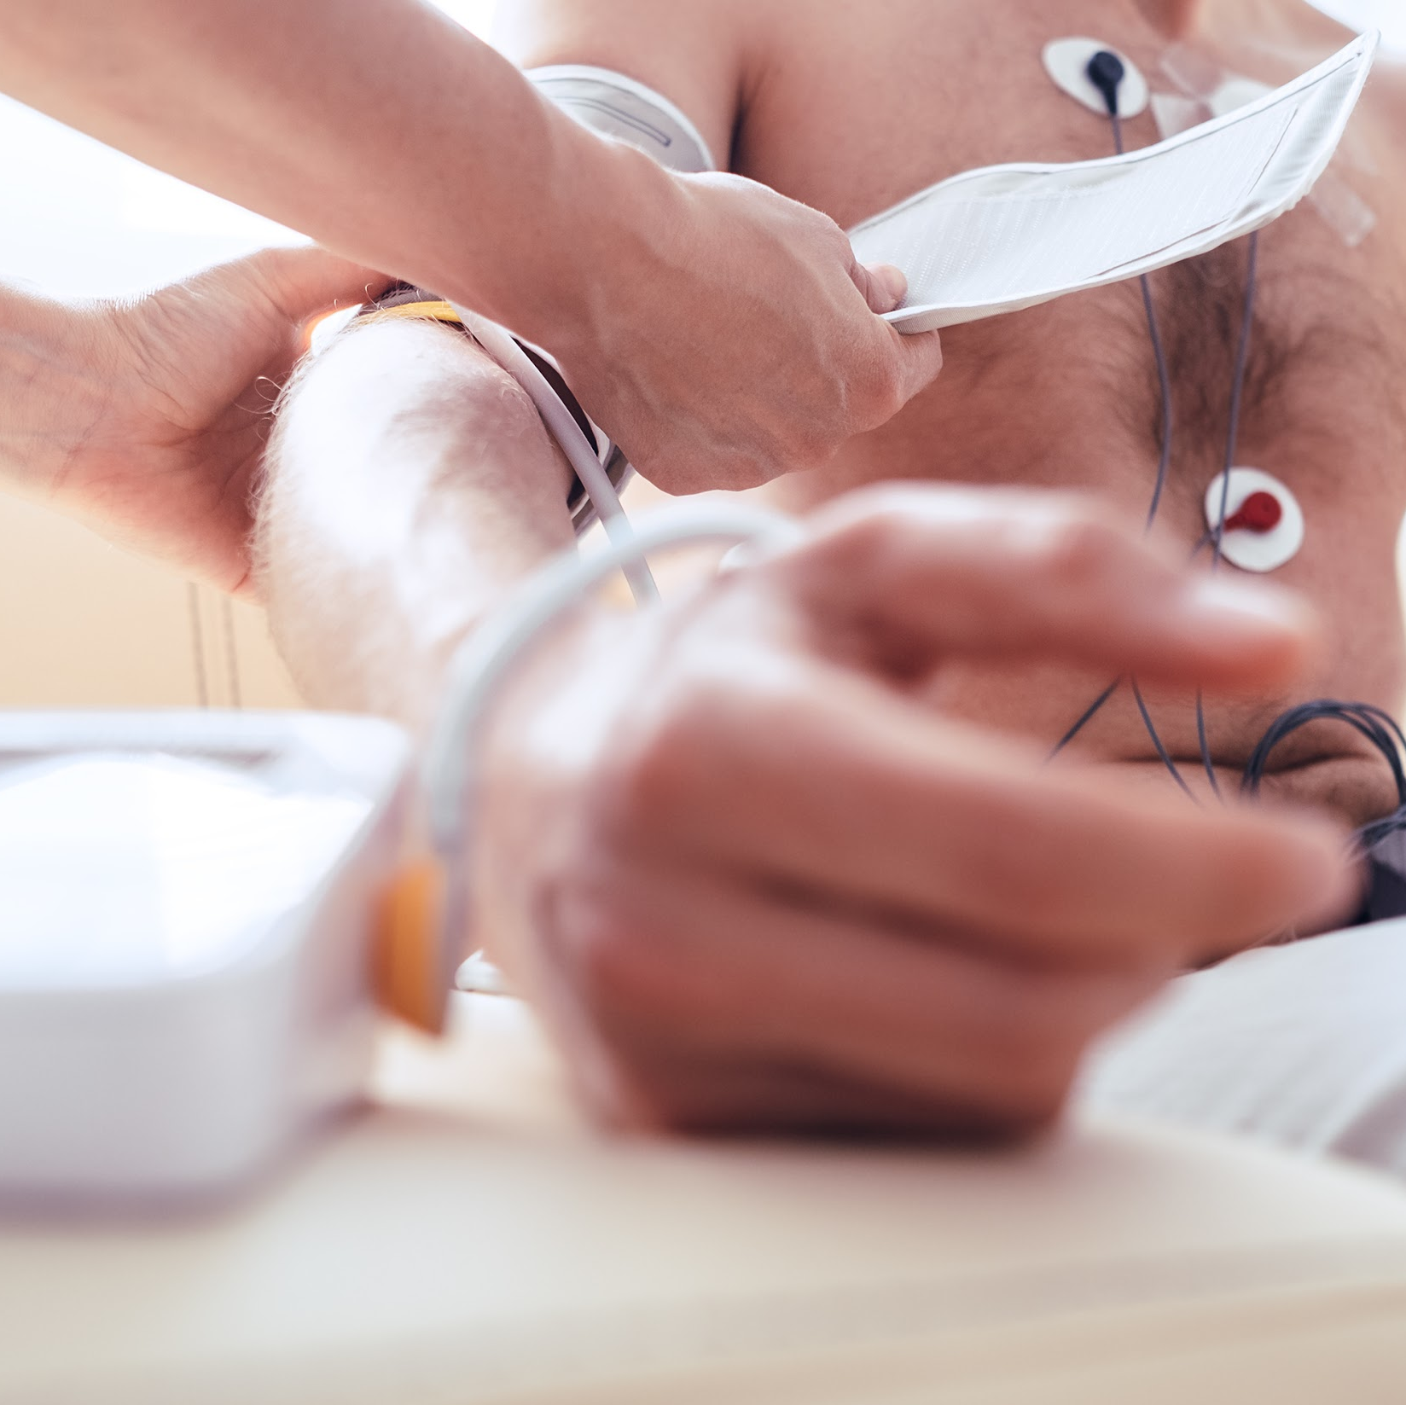
Enrollment Eligibility Requirements
Applicants must be 18 years of age or older and have a High School diploma or GED. Many employers will require that you have suitable vision and hearing (normal or corrected), suitable psychomotor skills, hand-eye coordination, and finger agility, and be able to stand for an extended period. This program prepares students for entry into a career as a Patient Care Technician by way of earning the Certified Patient Care Technician (CPCT) credential. There are currently no restrictions or regulations that prevent or restrict a CPCT from obtaining employment in this field, however, State Boards may have instituted restrictions on tasks that may be performed by Patient Care Technician within certain environments or under specific job titles, therefore prospective PCT’s should acquaint themselves with these scope of practice laws. A Patient Care Technician may be required to register to become licensed in their home-state.
**PLEASE NOTE: While MedCerts training and related target certifications may be accepted and/or approved by your state of residency, employers reserve the right to dictate pre-requisite education, experience, or certification/licensure requirements for their positions. We strongly advise students to research target job posts from area employers and relevant state requirements, barriers, or restrictions prior to enrollment to ensure eligibility upon graduation.

Slide 10

Patient Care Technician Courses

Slide 11
PS-1011: Professionalism in Allied Health
Description:
This course will benefit anyone considering a career in allied health, as well as those already working in the field. Allied Health Professionals must be committed to the key attributes of professionalism and strive to reflect this within the delivery of patient-centered safe and effective care. “Professionalism” is a broad term that reflects many different skills and abilities. For an individual to exhibit professionalism, he/she must be armed with specific skills and abilities that do not always show up within certification requirements, or even within a career training curriculum. Soft skills are hard to measure and are typically less well-defined than hard skills. However, soft skills are what set many job candidates apart. Professionalism is not just what one knows, it is how one does their job, how one behaves and how one comes across as they interact with others.
The purpose of this course is to provide students with soft skills training that will provide the tools needed to demonstrate a higher level of professionalism on the job. Key components of the course focus on patient interaction, proper office behavior, medical ethics, diversity and cultural bias, emotional strength, professional appearance and communication. The course maintains a focus on the key attributes that are true markers of professionalism.
This course was created with input from healthcare professionals working in the field, healthcare employers that hire our graduates, professional educators and even former MedCerts students. The end result is a collection of modules that touch on the soft skills that are TRULY important in the real world of allied healthcare. In this course, students are engaged through scenario-based learning that allows for real interaction with virtual co-workers and patients. Additionally, game-based activities keep students engaged and entertained throughout their learning journey.
Course Objectives:
Gain an understanding of the expectations of an allied healthcare professional in the workplace
Develop and exercise emotional intelligence, self-management and interpersonal skills
Build and improve internal and external communication skills with all exchanges
Enhance the patient care experience with successful interactions and patient satisfaction
Maintain solution-oriented conversations, manage conflict and build self-confidence

Slide 12
HI-1014: Introduction to Human Anatomy and Medical Terminology
Description:
In this Introduction to Human Anatomy & Medical Terminology course, you will uncover the wonderful diversity of the 11 body systems while learning about the medical language that is used to describe them, and the translation of medical records used in the field of healthcare. Within the Anatomy & Physiology section of each Lesson, students will gain comprehensive knowledge of the structure and function of the various organs and systems of the human body. Major diseases and conditions will be presented and explained in the section on Pathology. Throughout each Lesson, the roots of terms are explained to help students understand how medical terminology works in all areas of healthcare and to increase their knowledge and understanding of the material discussed.
This module will provide you with a better understanding and working knowledge of medicine that is required in dictation and translation of medical records used for multiple purposes and job duties in the medical field. Modules include: Introduction to Medical Terminology; Introduction to Anatomy, Physiology and Pathology; Cells – The Foundation of Life; The Human Body; Integumentary System; Skeletal System; Muscular System; Nervous System; Special Senses; Endocrine System; Cardiovascular System; Blood and Immune Systems; Respiratory System; Digestive System; Urinary System; and Reproductive System.
Course Objectives:
Recognize the structure and function of the 11 body systems and their organs
Understand the medical language that is used to describe those systems
Analyze and understand medical terms by breaking down their word components
Appreciate the major diseases and conditions related to the human body
Apply your knowledge within the healthcare setting

Slide 13
HI-6011: Phlebotomy
Description:
Phlebotomy is a comprehensive course with insight and focus on specimen collection for diagnostic testing in the healthcare facility, providing foundational knowledge required of an allied healthcare professional. Video-based lessons include fundamentals of phlebotomy with emphasis on infection control, safety, communication skills, patient care and preparation, venipuncture equipment and supplies, specimen collection, handling, transport and processing.
In this course, students are exposed to a variety of eLearning elements that allow for hands-on interaction with the screen for an engaging education. Simulations will provide the student opportunities to practice key phlebotomy skills performed in a medical facility. In addition to video-based instruction and simulation, a variety of other learning methods are utilized for engagement, entertainment and inspiration throughout training..
Course Objectives:
Recognize the importance of infection control and safety compliance with diagnostic testing
Understand the responsibilities of teamwork and communication skills in the healthcare setting
Appreciate the role of the Phlebotomy Technician in patient care, preparation and venipuncture
Identify proper organization and utilization of specimen collection equipment and supplies
Gain an understanding of blood and non-blood collections, handling, transport and processing

Slide 14
HI-6012: Electrocardiography
Description:
Electrocardiography is a comprehensive course with insight and focus on diagnostic cardiac testing in the healthcare facility, providing foundational knowledge required of an allied healthcare professional. Video-based lessons include the fundamentals of electrocardiogram performance, Holter monitor application and assistance with stress testing. An emphasis is placed on cardiac arrhythmias. Patient care, preparation and monitoring are addressed along with standard precautions and the Occupational Safety and Health Administration (OSHA).
In this course, students are exposed to a variety of eLearning elements that allow for hands-on interaction with the screen for an engaging education. Simulations will provide the student opportunities to practice key electrocardiography skills performed in a medical facility. In addition to video-based instruction and simulation, a variety of other learning methods are utilized for engagement, entertainment and inspiration throughout the training.
Course Objectives:
Appreciate the role of electrocardiography in the healthcare setting
Understand the responsibilities of patient care and monitoring, safety and compliance
Gain an understanding of the use of appropriate electrocardiography equipment and supplies
Understand diagnostic cardiac testing to include electrocardiograms, Holter monitors and stress tests
Recognize arrhythmias and artifacts with appropriate responses required

Slide 15
HI-7011: Fundamentals of Patient Care
Description:
Fundamentals of Patient Care is a comprehensive course that focuses on the current and evolving role of patient care in the healthcare setting. Video-based lessons include fundamentals of patient care, compliance and safety, professional responsibility, infection control, basic emergency care, patient assessment and vital signs, and grooming/hygiene. Topics related to specific patient-types are also to be addressed, including caring for older adults, pediatric, and special needs patients. The course also details the importance of teamwork in the healthcare environment, and breaks down the various roles that professionals fill as it relates to patient care whether through supporting chronic conditions, emergency, or end-of-life care.
Students are exposed to a variety or eLearning elements that allow for hands-on interaction with the screen for an engaging learning experience. Clinical simulations will provide the student opportunities to practice key clinical skills performed in a medical facility. In addition to video-based instruction and simulation, a variety of other learning methods are utilized for engagement, entertainment, and inspiration throughout training.
Course Objectives:
Appreciate the role of patient care in the healthcare setting
Recognize the importance of safety and compliance
Understand the responsibilities of communication and professionalism
Gain an understanding of assistance with activities of daily living
Recognize the importance of special care, concerns and settings

Slide 16
Experiential Learning Opportunity
Description:
Graduates of this program are strongly encouraged to pursue supervised administration of required Phlebotomy and EKG tasks required for certification. These are additional requirements after obtaining employment in the field as a prerequisite to gaining additional certification as a Certified EKG Technician (CET) or a Certified Phlebotomy Technician (CPT) and are not included in this program.
Career Services and Experiential Learning Support
MedCerts Careers Services Advisors work with local, regional and national employers to find Experiential Learning opportunities for students during and after their MedCerts program. Our primary goal is to find full-time job placement for every student. If immediate employment is not an option, our team will work with students to find Experiential Learning opportunities to provide hands-on experience. Typical Experiential Learning options include job shadowing experiences, volunteer opportunities, externships or internships. Experiential Learning allows us to tailor our efforts to what works in each healthcare market to match the needs of employers and students.
*MedCerts does not guarantee an experiential site for every student. Placement in experiential learning is dependent on many factors including but not limited to the location of the student.

Slide 17

Eligible Program Certifications

Slide 18
Certified Patient Care Technician (CPCT)
An individual that has completed training and has passed the Certified Patient Care Technician examination demonstrates proficiency in the field and more importantly ensures the safety of patients while under supervised care. More and more patients require special care, sometimes around-the-clock. Needs vary from patient to patient, making it vital that the Patient Care Technician has a diverse range of knowledge and skills to provide their basic care.
Common duties of a Patient Care Technician include tasks like:
Provide basic patient care - bathing, feeding, catheter care, etc.
Acquire, distribute, and administer patient care supplies
Perform safety checks and ensure cleanliness in patient rooms
Accommodate the special needs of patients accordingly
Obtain EKG readings and monitor vital signs
Perform phlebotomy procedures
Provide emotional support to patients and families, particularly coping with grief and death
Having a nationally accredited certification, like the CPCT, can help you stand out. Certification may also be required or preferred for certain job opportunities in the profession.
CPT Certification Exam Details:
Number of Questions: 100 Questions, 20 pretest questions
Exam Time: 1 hour, 50 minutes
Passing Score: 390/500
NHA National Pass Rate: 75.6%
NHA Total Certified in 2018: 6,704
Total Currently Certified: 15,368

Slide 19

Potential Careers & Job Outlook

Slide 20
Patient Care Technician Careers
The Patient Care Technician program prepares students for a career as a Patient Care Technician and other closely related careers, which have projected job growth of 21% from 2012 to 2022 according to the Bureau of Labor Statistics (bls.gov). Much of this growth will be the result of an increase in the number of group practices, clinics, and other facilities that need a high number of support personnel.
PCT salaries can vary from one organization to the next. According to ZipRecruiter, the average national salary as of December 2018 is $29,000. Annual salaries can be as high as $47,000, and usually range between $24,500 (25th percentile) to $31,000 (75th percentile across the country,
PRIMARY O*NET CODE: 39-9021.00 – Personal Care Aides
Assist the elderly, convalescents, or persons with disabilities with daily living activities at the person’s home or in a care facility. Duties performed at a place of residence may include keeping house (making beds, doing laundry, washing dishes) and preparing meals. May provide assistance at non-residential care facilities. May advise families, the elderly, convalescents, and persons with disabilities regarding such things as nutrition, cleanliness, and household activities.
Sample of reported job titles: Caregiver, Certified Nursing Assistant (CNA), Home Care Aide, Home Health Care Provider, Medication Aide, Patient Care Assistant (PCA), Personal Care Aide, Personal Care Assistant (PCA), Personal Care Attendant (PCA), Resident Care Assistant (RCA).
PRIMARY O*NET CODE: 31-1014.00 – Nursing Assistants
Provide basic care under direction or nursing staff. Perform duties such as feed, bathe, dress, groom, or move patients or change linens. May transfer or transport patients. Includes nursing care attendants, nursing aides, and nursing attendants.
Sample of reported job titles: Certified Medication Aide (CMA), Certified Nurse Aide (CNA), Certified Nurse’s Aide (CNA), Certified Nursing Assistant (CNA), Geriatric Nursing Assistant (GNA), Licensed Nursing Assistant (LNA), Nurses’ Aide, Nursing Aide, Nursing Assistant, State Tested Nursing Assistant (STNA).

Slide 21
Patient Care Technician Careers (cont.)
PRIMARY O*NET CODE: 31-1011.00 – Home Health Aides
Provide routine individualized healthcare such as changing bandages and dressing wounds, and applying topical medications to the elderly, convalescents, or persons with disabilities at the patient’s home or in a care facility.. Monitor or report changes in health status. May also provide personal care such as bathing, dressing, and grooming of patient.
Sample of reported job titles: Certified Medication Aide (CMA), Certified Nurse Aide (CNA), Certified Nurse’s Aide (CNA), Certified Nursing Assistant (CNA), Geriatric Nursing Assistant (GNA), Licensed Nursing Assistant (LNA), Nurses’ Aide, Nursing Aide, Nursing Assistant, State Tested Nursing Assistant (STNA).
Top Employers Nationally: Genesis Healthcare Corporation, Hospital Corporation of America, Fresenius, Davita Incorporated, Brookdale Senior Living, LHC Group, HCR ManorCare, Sunrise Senior Living, Inc, Tenet Health System, Catholic Health Initiatives.

