Slide 1
Clinical Medical Professional
Program Guide
Prepared For: [Insert StudentName]
Estimated Start Date: [Insert Date]
Program Cost: $6000.00
Program Code: HI-9700

Slide 2
Clinical Medical Professional Details

Slide 3
What is a Medical Assistant?
Medical Assistants are multi-skilled allied healthcare professionals who work to administer medications, assist with minor procedures, record vital signs, take medical history, prepare patients and rooms for examinations, obtain laboratory specimens, provide patient education, and much more. Because of the specialized skill set and knowledge that is held by these professionals, they find themselves working in clinics, physicians’ offices, hospitals, outpatient facilities, and specialists’ offices across the country.
Medical Assistants will largely or solely work alongside the physician in providing patient care but may also be called upon to take care of the non medical aspects of the practice by completing paperwork, filing records, handling insurance, performing billing and bookkeeping, answering phones and more.
Because physicians often have very large patient loads, they use Medical Assistants as valuable aids to complete many of the routine tasks involved in patient care. Because the duties performed by medical assistants are determined and governed by state law, they may vary from one place to the next. The Clinical Medical Assistant will dispose of contaminated supplies, sterilize instruments, collect and prepare laboratory specimens, and perform basic laboratory tests. In very small offices, the Medical Assistant may also be responsible for a number of other duties, including maintaining and ordering supplies, completing patient charts and insurance claims, answering phones, scheduling appointments, and more. The duties of these professionals are performed under the supervision of physicians and other licensed healthcare providers.
According to the US Bureau of Labor Statistics (BLS), the field of Clinical Medical Assisting is expected to grow 23% by 2024, which is faster than average for all occupations.
In this field, certification is important to stand out in a competitive
market. While certification may not be required in most states,
employers prefer hiring individuals who have demonstrated
mastery of Medical Assisting skills and concepts through
certification. Many employers offer career laddering
opportunities with elevated responsibilities and pay. These
roles include medical scribe, health coach, patient navigator,
patient care coordinator, and population health manager.

Slide 4
What is a Medical Assistant? (cont.)
While the majority of Medical Assistants stay in the same type of work for at least five years, those that move into related fields often choose between clinical and administrative specialties. Those who choose clinical often become Medical Laboratory Technicians, Certified Nursing Assistants, Physical Therapy Assistants, Surgical Technicians, or Respiratory Technicians. Those who choose administrative often move into billing, coding, management, research, or other non-clinical career paths.

Slide 5
Program Description
The MedCerts online Clinical Medical Professional program prepares students to gain industry certification and ultimately to work in hospitals, clinics, physician’s offices, and other healthcare facilities. Our highly immersive program utilizes 12 unique eLearning components designed to keep students engaged, stimulated, and entertained throughout their training. The student learning experience is driven by recorded video lecture delivered by expert instructors with simulations, video demonstrations, virtualized environments, and many other professionally produced learning objects. Multiple assessments test the students’ knowledge and understanding of the material contained in each lesson leading up to the comprehensive final exam for each course.
Because today’s Medical Assistant will be called upon to perform a variety of clinical administrative duties, the MedCerts program covers a wide range of skills and objectives that expand beyond the routine functions of a Medical Assistant. Chief among these expanded responsibilities are tasks related to and around the practices of Phlebotomy and Electrocardiography (ECG/EKG). This program contains two additional courses specifically designed to prepare the student with the knowledge and skills necessary to perform blood draws, collect and handle blood and non-blood specimens, administer EKGs and other diagnostic tests, while maintaining a safe clinical environment.
Upon completion of this program, graduates will have met the training requirements to sit for the Certified Clinical Medical Assistant (CCMA) exam and the Certified MEdical Administrative Assistant (CMAA) exam, both of which are sponsored by the National Healthcareer Association (NHA). Additionally, students will have completed the training requirements for the Certified Phlebotomy Technician (CPT) and Certified EKG Technician (CET) certifications sponsored by the NHA. Once hired as a Medical Assistant, the student can complete the required 30 successful
venipunctures and 10 capillary sticks that are necessary to attempt the
Phlebotomy certification exam, and the 10 EKG readings required
for the EKG certification.
Because Customer Service is a priority in situations where
direct care or other patient/client interaction occurs, students
will learn the fundamentals of Customer Service by
completing a module that has been aligned with standards
set forth by the Professional Association for Customer
Engagement (PACE). Students that successfully complete this
module will attain the status of Customer Service Certified (CSC).

Slide 6
Who is this program recommended for?
The Clinical Medical Professional program is recommended for those who want to work directly with patients in a clinical medical environment. Medical Assistants will largely or solely work alongside the physician in providing patient care but may also be called upon to take care of the non medical aspects of the practice by completing paperwork, filing records, handling insurance, performing billing and bookkeeping, answering phones, and more.
Graduates of this program differentiate themselves from the field of Medical Assistants by completing comprehensive courses in Phlebotomy and Electrocardiography (EKG), creating a path for the Medical Assistant to perform advanced job roles and expanded responsibilities that can lead to greater marketability and earning power.

Slide 7
Program Objectives & Features
Objectives
Gain knowledge of medical terminology, disease processes, anatomy, and physiology
Appreciate the role of the Clinical Medical Assistant in general, specialty, and surgical practices
Gain an understanding of the laboratory specimen collection techniques, and cardiopulmonary testing
Recognized the importance of pharmacology and medication administration
Appreciate the role of the Phlebotomy Technician in patient care, preparation and venipuncture
Gain an understanding of blood and non-blood collections, handling, transport and processing
Appreciate the role of electrocardiography in the healthcare setting
Understand diagnostic cardiac testing to include electrocardiograms, Holter monitors and stress tests
Grasp the importance of customer service, communication skills, and professionalism
Prepare for certification as a Certified Clinical Medical Assistant (CCMA)
Students receive ongoing support and guidance from a team of instructors, advisors, and online mentors. The registration and cost for the certification exams (CCMA and CMAA) are covered by MedCerts. For additional information, visit MedCerts.com.
Features
Comprehensive New Student Orientation
An assigned Student Support Specialist who provides 1:1 support from start to finish.
Professional support offered through on-demand subject matter experts
12-Month Access to Online Training
Flexible scheduling that allows you to learn at your own pace
Certification Exam Payment and Registration
Exam Preparation Support
Career Services and Experiential Learning Support

Slide 8
Equipment & Courseware/eBooks
Students must have (or have access to) a computer with high-speed internet (minimum 1.5Mbs). MedCerts provides all required courseware, student guides, study guides and other program supplements and resources. In addition to the online video content, students will be provided access to all relevant labs and online/offline resources as necessary to complete the program.
Program Components Include
Introduction to Human Anatomy & Medical Terminology (MedCerts) Recorded Video-Based Lecture/Instruction
Introduction to Human Anatomy & Medical Terminology: A Course Companion (Reuter, Weiss) MedCerts 1st Edition eText and Workbook
A&P with Medical Terms Flashcards (MedCerts) MedCerts
Medical Office Procedures and Administration (MedCerts) Recorded Video-Based Lecture/Instruction
Kinn’s The Administrative Medical Assistant (Proctor, Niedzwiecki, Pepper and Madero) Elsevier 13th Edition eBook (from VitalSource)
Medical Assisting Demonstration Videos (Elsevier Copyright 2017) Interactive Video
Storyline Animations (MedCerts) Skill Presentations and Knowledge Checks
Medical Administrative Assistant 3D Virtual Scenarios (MedCerts)
Clinical Medical Assisting (MedCerts) Recorded Video-Based Lecture/Instruction
Kinn’s The Clinical Medical Assistant (Proctor, Niedzwiecki, Pepper and Madero) Elsevier 13th Edition eBook (from VitalSource)
Body Spectrum (Elsevier Copyright 2014) Interactivity
Medical Assisting Demonstration Videos (Elsevier Copyright 2017)
Storyline Animations (MedCerts) Skill Presentations and Knowledge Checks
SIMTICs Clinical Procedures Simulation Training
Phlebotomy (MedCerts) Recorded Video-Based Lecture/Instruction
Phlebotomy Worktext and Procedures Manual 4E (Elsevier Copyright 2016) by Warekois and Robinson eBook (from VitalSource)
Phlebotomy Procedure Videos Elsevier Copyright 2016)
Drag and Drop Exercises Interactive Lesson Review (Elsevier Copyright 2016)
Phlebotomy Storyline Animations Skill Presentations and Knowledge Checks (MedCerts)
Phlebotomy Technician 3D Virtual Scenarios (MedCerts)
Phlebotomy and Capillary Procedures Simulation Training (SIMTICs)

Slide 9
Equipment & Courseware/eBooks (cont.)
Electrocardiography (MedCerts) Recorded Video-Based Lecture/Instruction
Electrocardiography for Healthcare Professionals 5F (McGraw Hill Copyright 2019) by Booth and O’Brien eBook (from VitalSource)
Electrocardiography Storyline Animations Skill Presentations and Knowledge Checks (MedCerts)
EKG Technician 3D Virtual Scenarios (MedCerts)
EKG Technician UNREAL 3D Virtual Games (MedCerts)
EKG and Analysis Simulation Training (SIMTICs)

Slide 10
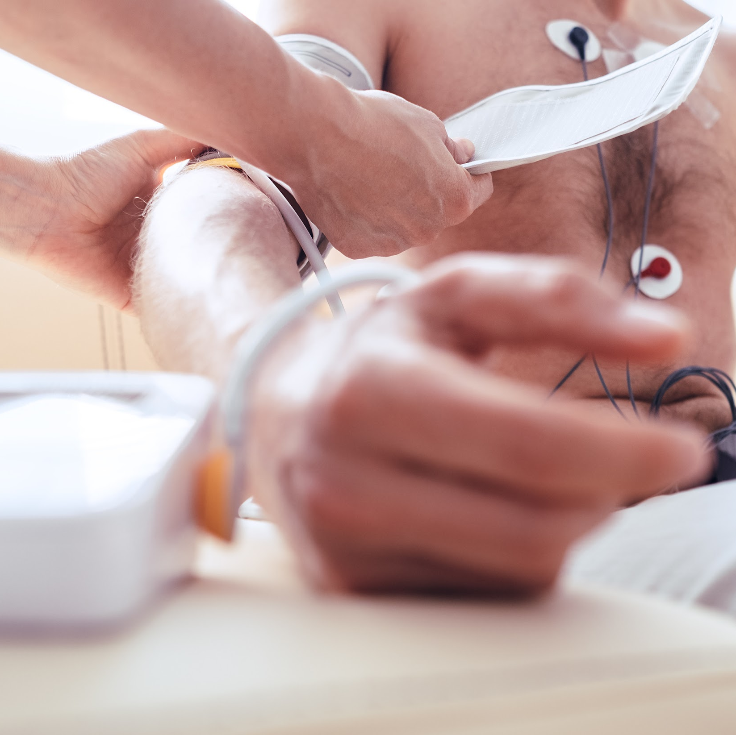
Enrollment Eligibility Requirements
Applicants must be 18 years of age or older, and have a High School diploma or GED. Many employers will require that you have suitable vision and hearing (normal or corrected), suitable psychomotor skills, hand-eye coordination, and finger agility, and be able to stand for an extended period. This program prepares students for entry into a career as a Medical Assistant by way of earning the Certified Clinical Medical Assistant (CCMA) credential. State Boards may have instituted restrictions on tasks that may be performed by the Medical Assistant, therefore prospective MAs should acquaint themselves with these scope of practice laws.
Individuals that reside in California, West Virginia, South Dakota, and Washington may not be eligible for licensure/registration as a Medical Assistant after completing this program due to additional state regulation or requirements.
Individuals that reside in California will NOT be eligible to work as a Phlebotomist after completing this program, as these states have specific additional requirements for licensure.
**PLEASE NOTE:
1) This program is NOT available to students who plan to work in the state of Washington. Many states have licensing or certification requirements for those performing the role of a Medical Assistant. This MedCerts program is aligned with and/or prepares candidates for certification or licensure in each state except Washington.
2) While MedCerts training and related target certifications may be accepted and/or approved by your state of residency, employers reserve the right to dictate pre-requisite education, experience, or certification/licensure requirements for their positions. We strongly advise students to research target job posts from area employers and relevant state requirements, barriers, or restrictions prior to enrollment to ensure eligibility upon graduation.

Slide 11
Clinical Medical Professional Courses

Slide 12
PS-1011: Professionalism in Allied Health
Description:
This course will benefit anyone considering a career in allied health, as well as those already working in the field. Allied Health Professionals must be committed to the key attributes of professionalism and strive to reflect this within the delivery of patient-centered safe and effective care. “Professionalism” is a broad term that reflects many different skills and abilities. For an individual to exhibit professionalism, he/she must be armed with specific skills and abilities that do not always show up within certification requirements, or even within a career training curriculum. Soft skills are hard to measure and are typically less well-defined than hard skills. However, soft skills are what set many job candidates apart. Professionalism is not just what one knows, it is how one does their job, how one behaves and how one comes across as they interact with others.
The purpose of this course is to provide students with soft skills training that will provide the tools needed to demonstrate a higher level of professionalism on the job. Key components of the course focus on patient interaction, proper office behavior, medical ethics, diversity and cultural bias, emotional strength, professional appearance and communication. The course maintains a focus on the key attributes that are true markers of professionalism.
This course was created with input from healthcare professionals working in the field, healthcare employers that hire our graduates, professional educators and even former MedCerts students. The end result is a collection of modules that touch on the soft skills that are TRULY important in the real world of allied healthcare. In this course, students are engaged through scenario-based learning that allows for real interaction with virtual co-workers and patients. Additionally, game-based activities keep students engaged and entertained throughout their learning journey.
Course Objectives:
Gain an understanding of the expectations of an allied healthcare professional in the workplace
Develop and exercise emotional intelligence, self-management and interpersonal skills
Build and improve internal and external communication skills with all exchanges
Enhance the patient care experience with successful interactions and patient satisfaction
Maintain solution-oriented conversations, manage conflict and build self-confidence

Slide 13
HI-1014: Introduction to Human Anatomy and Medical Terminology
Description:
In this Introduction to Human Anatomy & Medical Terminology course, you will uncover the wonderful diversity of the 11 body systems while learning about the medical language that is used to describe them, and the translation of medical records used in the field of healthcare. Within the Anatomy & Physiology section of each Lesson, students will gain comprehensive knowledge of the structure and function of the various organs and systems of the human body. Major diseases and conditions will be presented and explained in the section on Pathology. Throughout each Lesson, the roots of terms are explained to help students understand how medical terminology works in all areas of healthcare and to increase their knowledge and understanding of the material discussed.
This module will provide you with a better understanding and working knowledge of medicine that is required in dictation and translation of medical records used for multiple purposes and job duties in the medical field. Modules include: Introduction to Medical Terminology; Introduction to Anatomy, Physiology and Pathology; Cells – The Foundation of Life; The Human Body; Integumentary System; Skeletal System; Muscular System; Nervous System; Special Senses; Endocrine System; Cardiovascular System; Blood and Immune Systems; Respiratory System; Digestive System; Urinary System; and Reproductive System.
Course Objectives:
Recognize the structure and function of the 11 body systems and their organs
Understand the medical language that is used to describe those systems
Analyze and understand medical terms by breaking down their word components
Appreciate the major diseases and conditions related to the human body
Apply your knowledge within the healthcare setting

Slide 14
HI-1011: Medical Office Procedures and Administration
Description:
This course will introduce the student to the healthcare industry, its environment along with the day to day skill sets and knowledge required to fulfill a position as a Medical Administrative Assistant. Video-based lessons include Professional Behavior, Medicine and the Law, HIPAA and HITECH Regulations, Ethics, Communication and Interpersonal Skills, Patient Education, Written Communication and Correspondence, Telephone Techniques and Etiquette, Appointment Scheduling, Daily Operations, Patient Intake and Processing, Technology in the Medical Office, Managing Medical Records, Health Information Management, Health Insurance Basics, Basics of Coding, Medical Reimbursement Basics, Patient Accounts and Collections, Accounting and Bookkeeping, and Banking Services and Procedures.
In this course, students are exposed to a variety of eLearning modules that allow for hands-on interaction with the screen for an engaging introduction to the Medical Front Office. With the use of a 3D virtual environment, students experience various interactions and conversations between patients and the Medical Administrative Assistant. Each scenario represents a real-life interaction that will teach valuable skills for engaging with patients. Additional scenarios provide a unique look at performing specific office functions in a healthcare environment. In addition to video-based instruction and simulation, a variety of other learning methods are utilized to keep the student engaged, entertained, and inspired throughout their training.
Course Objectives:
Be able to follow HIPAA & HITECH Compliance Laws
Understand the different kinds of insurances and plans
Learn how to perform Medical Front Office Procedures
Learn the process of scheduling patients
Understand how to provide patient education

Slide 15
HI-6010: Clinical Medical Assisting
Description:
Clinical Medical Assisting is a comprehensive course with insight and focus on patient care in the healthcare facility, providing foundational knowledge required of an allied healthcare professional. Video-based lessons include fundamentals of clinical medical assisting with emphasis on infection control, vital signs, the clinical laboratory, general and specialty physical examinations, urinalysis, microbiology, immunology, nutrition, cardiopulmonary diagnostic testing, pharmacology, medication administration, phlebotomy, hematology, surgical procedure assisting and emergency preparedness. Topics related to diversity, patient interaction, documentation and communication will be addressed. Throughout each lesson, the role of the clinical medical assistant will be presented and explained as applicable to patient education and legal & ethical issues.
In this course, students are exposed to a variety of eLearning elements that allow for hands-on interaction with the screen for an engaging education. Clinical simulations will provide the student opportunities to practice key clinical skills performed in a medical facility. In addition to video-based instruction and simulation, a variety of other learning methods are utilized for engagement, entertainment and inspiration throughout training.
Course Objectives:
Learn the fundamentals of clinical medical assisting
Gain an understanding of infection control, vital signs, the clinical laboratory, general and specialty physical examinations, urinalysis, and microbiology.
Learn about immunology, nutrition, cardiopulmonary diagnostic testing, pharmacology, medication administration, phlebotomy, hematology, and emergency preparedness.
Appreciate the role of the clinical medical assistant and how it applies to patient education and legal & ethical issues.

Slide 16
HI-6011: Phlebotomy
Description:
Phlebotomy is a comprehensive course with insight and focus on specimen collection for diagnostic testing in the healthcare facility, providing foundational knowledge required of an allied healthcare professional. Video based lessons include fundamentals of phlebotomy with emphasis on infection control, safety, communication skills, patient care and preparation, venipuncture equipment and supplies, specimen collection, handling, transport, and processing.
In this course, students are exposed to a variety of eLearning elements that allow for hands-on interaction with the screen for an engaging education. Simulations will provide the student opportunities to practice key phlebotomy skills performed in a medical facility. In addition to video-based instruction and simulation, a variety of other learning methods are utilized for engagement, entertainment, and inspiration throughout training.
Course Objectives:
Recognize the importance of infection control and safety compliance with diagnostic testing
Understand the responsibilities of teamwork and communication skills in the healthcare setting
Appreciate the role of the Phlebotomy Technician in patient care, preparation, and venipuncture
Identify proper organization and utilization of specimen collection equipment and supplies
Gain an understanding of blood and non-blood collections, handling, transport, and processing

Slide 17
HI-6012: Electrocardiography
Description:
Electrocardiography is a comprehensive course with insight and focus on diagnostic cardiac testing in the healthcare facility, providing foundational knowledge required of an allied healthcare professional. Video-based lessons include the fundamentals of electrocardiogram performance, Holter monitor application, and assistance with stress testing. An emphasis is placed on cardiac arrhythmias. Patient care, preparation, and monitoring are addressed along with standard precautions and the Occupational Safety and Health Administration (OSHA).
In this course, students are exposed to a variety of eLearning elements that allow for hands-on interaction with the screen for an engaging education. Simulations will provide the student opportunities to practice key electrocardiography skills performed in a medical facility. In addition to video-based instruction and simulation, a variety of other learning methods are utilized for engagement, entertainment, and inspiration throughout the training.
Course Objectives:
Appreciate the role of electrocardiography in the healthcare setting
Understand the responsibilities of patient care and monitoring, safety, and compliance
Gain an understanding of the use of appropriate electrocardiography equipment and supplies
Understand diagnostic cardiac testing to include electrocardiograms, Holter monitors and stress tests
Recognize arrhythmias and artifacts with appropriate responses required

Slide 18
Eligible Program Certifications

Slide 19
Certified Clinical Medical Assistant (CCMA)
A Medical Assistant is a multi-skilled health care professional that specializes in procedures commonly performed in the ambulatory health care setting. Medical assistants perform both clinical and administrative duties and assist a variety of providers including physicians, nurse practitioners and physician assistants. They typically work in medical offices, clinics, urgent care centers and may work in general medicine or specialty practices.
Common duties of a medical assistant include administrative and clinical tasks like:
Checking patients in and out upon arrival and departure
Answering phone calls and questions
Assisting providers with exams and procedures
Administering injections and medications
Working in the electronic health record (EHR)
Performing EKG, phlebotomy, and laboratory procedures
Taking patient vital signs
Having a nationally accredited certification, like the CCMA, can help you stand out. Certification may also be required or preferred for certain job opportunities in the profession.
Many organizations are now offering career laddering opportunities for medical assistants with elevated responsibilities and pay. Elevated roles may include those of a scribe, health coach, patient navigator, population health manager and patient care coordinator.
CCMA Certification Exam Details:
Number of Questions: 150 Questions, 30 pretest questions
Exam Time: 3 hours
Passing Score: 390/500
NHA National Pass Rate: 72.9%
NHA Total Certified in 2018: 38,548
Total Currently Certified: 92,753

Slide 20
Medical Administrative Assistant Certification (CMAA)
Also referred to as Medical Office Secretary or Medical Office Assistant, the Certified Medical Administrative Assistant (CMAA) will perform routine administrative tasks to help keep the physicians’ offices and clinics running efficiently.
As a CMAA, you may perform some or all of the following tasks:
Review and answer practice correspondence
Operate computer systems or other types of technology to accomplish office tasks
Answer calls, schedule appointments, greet patients, and maintain files
Update and maintain patient and other practice-specific information
Working in the electronic health record (EHR)
Coordinate collection and preparation of operating reports such as time and attendance
Benefits to obtaining a Medical Administrative Assistant Certification may include:
More job opportunities
An increased pay scale
Increased subject matter expertise
CMAA Certification Exam Details:
Number of Questions: 110 Questions, 20 pretest questions
Exam Time: 2 hours, 10 minutes
Passing Score: 390/500
NHA National Pass Rate: 76%
NHA Total Certified in 2018: 11,292
Total Currently Certified: 18,622

Slide 21
Certified Phlebotomy Technician (CPT)
Hospitals, laboratories, and other employers have an increasing demand for phlebotomists. Most seek, and many require, a professional certification. With a CPT certification, you’ll have the credentials you need to set yourself apart from other applicants as you embark on a rewarding healthcare career. As more employers require phlebotomy certifications, a CPT will help improve your marketability in a growing and rewarding field.
Common duties of Phlebotomists include tasks like:
Draw blood from patients and blood donors
Evaluate patients’ ability to withstand procedure
Explain blood-drawing procedure to patients and answer questions
Perform basic point of care testing, such as blood glucose levels
Prepare blood, urine and other specimens for testing
Verify patient/donor identity
Maintain medical equipment such as needles, test tubes, and blood vials
Having a nationally accredited certification, like the CPT, can help you stand out. Certification may also be required or preferred for certain job opportunities in the profession.
Phlebotomy Technicians are critical team members at hospitals, diagnostic laboratories, and blood donor centers. As advancements in medical technology rise, it’s an especially exciting time to being a career in this thriving field. Earning your Phlebotomy Technician Certification (CPT) from NHA can give employers confidence in your skills and abilities. Set yourself up for success and reach your career goals in the rewarding healthcare industry.
Candidate Eligibility
Each candidate must be able to provide evidence that he/she has performed a minimum of:
30 successful venipunctures
10 successful capillary sticks
CPT Certification Exam Details:
Number of Questions: 100 Questions, 20 pretest questions
Exam Time: 2 Hours
Passing Score: 390/500
NHA National Pass Rate: 78.5%
NHA Total Certified in 2018: 37,085
Total Currently Certified: 89,554

Slide 22
Certified EKG Technician (CET)
EKG rhythms provide important data for the diagnosis of heart conditions. As a Certified EKG Technician (CET), you’ll have the credentials nearly all healthcare employers require to perform the critical tasks of conducting EKGs, as well as Holter monitoring and assisting with stress tesing. These tests can be performed during physical exams, when cardiovascular problems are suspected, or in preparation for surgery.
Common duties of a Patient Care Technician include tasks like:
Set up and conduct EKGs (electrocardiograms) and assist with stress tests
Prepare patients for Holter or ambulatory monitoring
Prepare and deliver final test results to physicians for analysis
Schedule appointments
Transcribe physicians’ interpretations
Having a nationally accredited certification, like the CET, can help you stand out. Certification may also be required or preferred for certain job opportunities in the profession.
The need for qualified EKG technicians continues to rise as the aging population in America grows (and with it, the prevalence of heart-related conditions). Earning your CET will help you launch a successful and meaningful career that can help make a difference in countless lives. Whether you seek full-time or part-time employment, the opportunities in this profession are flexible and in high demand. Plus, the added skills of Holter monitoring and stress tests required for the Certified EKG Technician (CET) will help you to be even more competitive as you launch your healthcare career.
Candidate Eligibility
Each candidate must be able to provide evidence that he/she has performed a minimum of:
10 successful EKGs on live individuals
CPT Certification Exam Details:
Number of Questions: 100 Questions, 20 pretest questions
Exam Time: 2 Hours
Passing Score: 390/500
NHA National Pass Rate: 88.4%
NHA Total Certified in 2018: 13,529
Total Currently Certified: 30,991

Slide 23
Potential Careers & Job Outlook

Slide 24
Clinical Medical Professional Careers
The Clinical Medical Professional program prepares students for a career as a Medical Assistant and other closely related careers, which have projected job growth of 23%, and has been identified as a Bright Outlook Occupation based on Bureau of Labor Statistics (www.bls.gov). Bright Outlook Occupations are expected to grow rapidly in the next several years or will have large numbers of job openings.
PRIMARY O*NET CODE: 31-9022.00 – Medical Assistants
Perform administrative and certain clinical duties under the direction of a physician. Administrative duties may include scheduling appointments, maintaining medical records, billing, and coding information for insurance purposes. Clinical duties may include taking and recording vital signs and medical histories, preparing patients for examination, drawing blood, and administering medications as directed by physician.
Sample of reported job titles: Certified Clinical Medical Assistant, Certified Medical Assistant, Laboratory Assistant, Chiropractor Assistant, Clinical Assistant, Doctor's Assistant, Medical Assistant, Medical Office Assistant, Ophthalmic Technician, Optometric Assistant, Optometric Technician, Registered Medical Assistant
2017 Median Wages: $16.15 hourly, $33,560 annual

